Slide 1
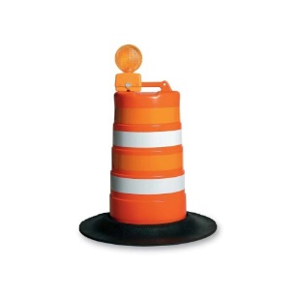

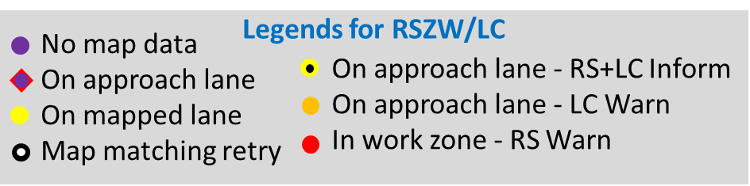
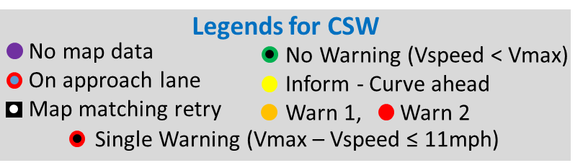








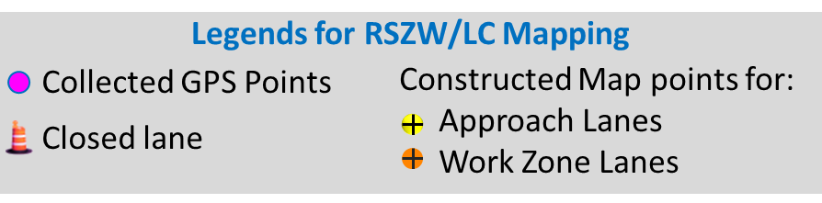
Legends for RSZW/LC
None
No map data
On approach lane
On mapped lane
Map matching retry
On approach lane - RS+LC Inform
On approach lane - LC Warn
In work zone - RS Warn
Inform
No Match
Warn 1
On Approach Lane
Warn 2
On Geometry Lane
Legends for CSW
Warn RS+LC
In Geometry Retry
No map data
On approach lane
Map matching retry
No Warning (Vspeed < Vmax)
Inform - Curve ahead
Warn 1, Warn 2
Inform RS+LC
Error/Other
Map data point
Vehicle Path
Data Point
Single Warning (Vmax – Vspeed ≤ 11mph)
Legends for RSZW/LC Mapping
Approach point
Collected GPS Points
Constructed Map Points for Approach Lanes
Constructed Map points for WZ Lanes
Closed Lane
Collected GPS Points
Closed lane
Constructed Map points for:
Approach Lanes
Work Zone Lanes

Slide 2
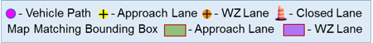
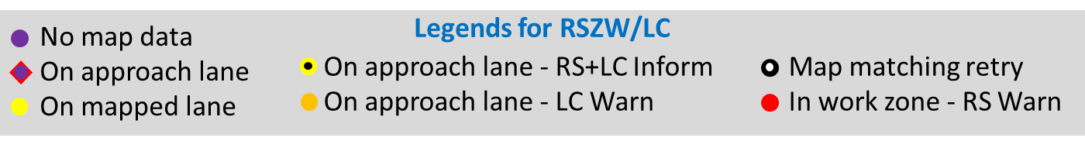
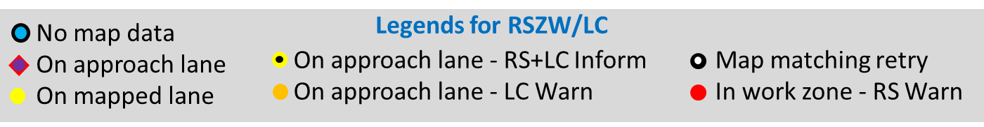
Legends for RSZW/LC
No map data
On approach lane
On mapped lane
Map matching retry
On approach lane - RS+LC Inform
On approach lane - LC Warn
In work zone - RS Warn
No Map Data
On Approach Lane
On Mapped Lane
On Approach Lane - RS+LC Inform
On approach lane - LC Warn
In work zone - RS Warn
Legends for RSZW/LC
No map data
On approach lane
On mapped lane
On approach lane - RS+LC Inform Map matching retry
On approach lane - LC Warn In work zone - RS Warn
Legends for RSZW/LC
No map data
On approach lane
On mapped lane
On approach lane - RS+LC Inform Map matching retry
On approach lane - LC Warn In work zone - RS Warn

Slide 3

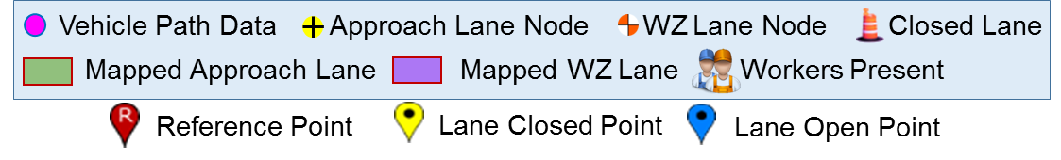
Legends for RSZW/LC + WZ Mapping
No map data
On approach lane
On mapped lane
On approach lane - RS+LC Inform Map matching retry
On approach lane - LC Warn In work zone - RS Warn
Legends for RSZW/LC
No map data
On approach lane
On mapped lane - Inform
On approach lane - RS+LC Inform Map matching retry
On approach lane - LC Warn In work zone - RS Warn
Legends for WZ Mapping
Vehicle Path Approach Lane - WZ Lane - Closed Lane
Vehicle Path Approach Lane - WZ Lane - Closed Lane
Map Matching Bounding Box Approach Lane WZ Lane
Map Matching Bounding Box Approach Lane WZ Lane
Vehicle Path Data Approach Lane Node WZ Lane Node Closed Lane
Mapped Approach Lane Mapped WZ Lane Workers Present
Reference Point
Lane Closed Point
Lane Open Point

Slide 4
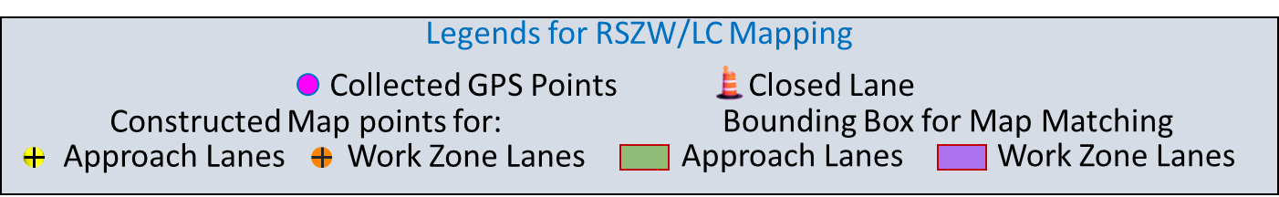
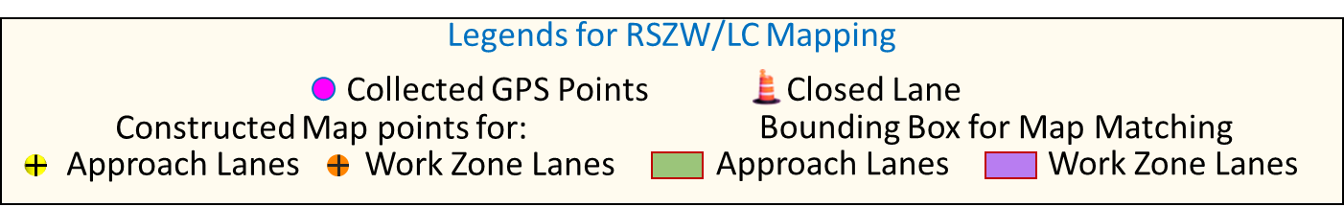
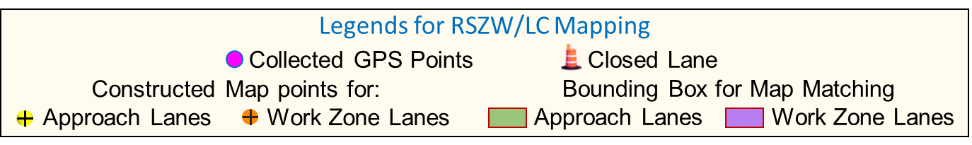
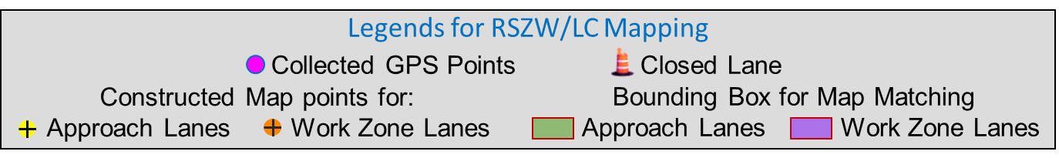
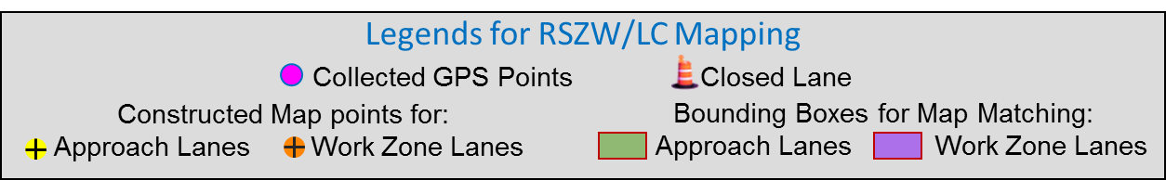
Collected GPS Points
Closed lane
Constructed Map points for:
Approach Lanes
Work Zone Lanes
Legends for RSZW/LC Mapping
Collected GPS Points Closed Lane
Constructed Map points for:
Approach Lanes Work Zone Lanes
Bounding Box for Map Matching
Approach Lanes Work Zone Lanes
Legends for RSZW/LC Mapping
Collected GPS Points Closed Lane
Constructed Map points for:
Approach Lanes Work Zone Lanes
Bounding Box for Map Matching
Approach Lanes Work Zone Lanes
Legends for RSZW/LC Mapping
Collected GPS Points Closed Lane
Constructed Map points for:
Approach Lanes Work Zone Lanes
Bounding Boxes for Map Matching:
Approach Lanes Work Zone Lanes

Slide 5
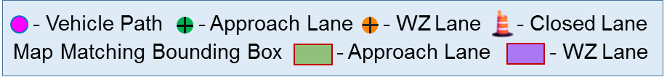
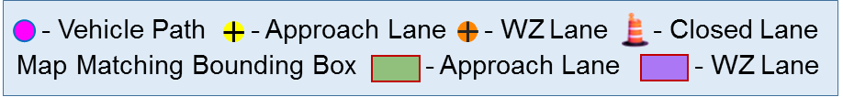
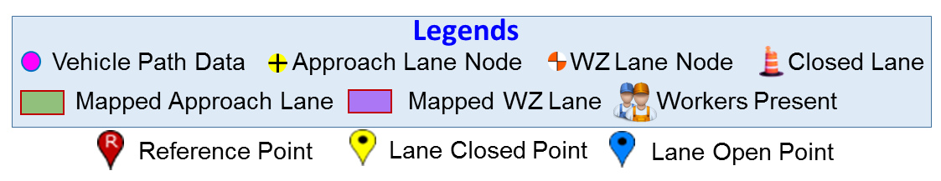
Legends for RSZW/LC Mapping
Collected GPS Points Closed Lane
Constructed Map points for:
Approach Lanes Work Zone Lanes
Bounding Boxes for Map Matching:
Approach Lanes Work Zone Lanes
- Vehicle Path - Approach Lane - WZ Lane - Closed Lane
Map Matching Bounding Box - Approach Lane - WZ Lane
Legends
Vehicle Path Data Approach Lane Node WZ Lane Node Closed Lane
Mapped Approach Lane Mapped WZ Lane Workers Present
Reference Point
Lane Closed Point
Lane Open Point

Slide 6








Slide 7



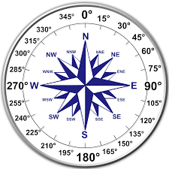

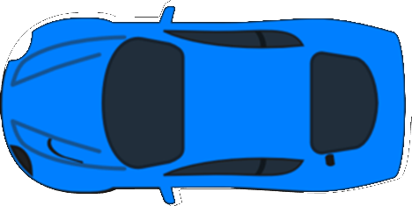









Slide 9
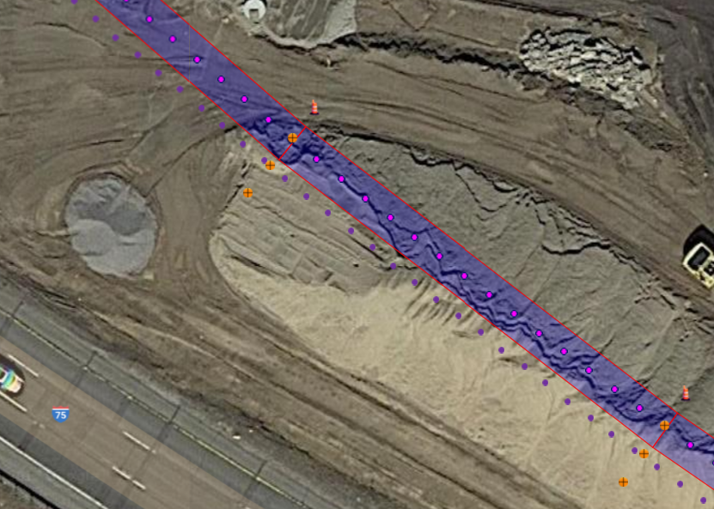

Slide 10
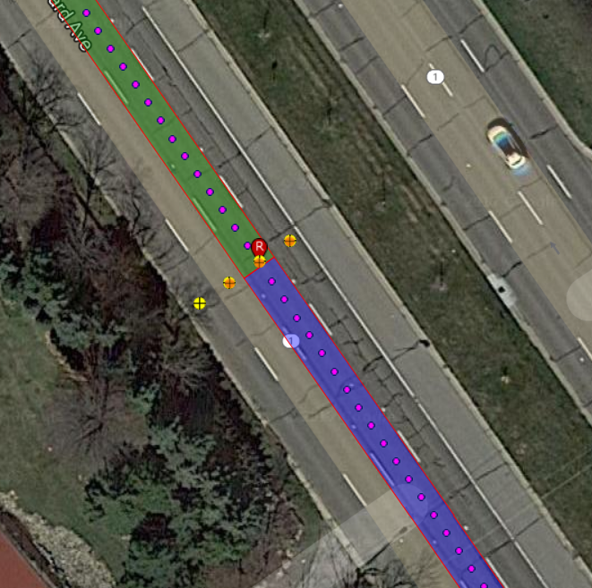
















Slide 11




Open

